Slide 1

Mobile Wallet Financial Product Report Module
Made by :
Sanket Jain (12bce081)
Snehal Parmar (12bce098)
Internal Guide: Prof. Vijay Ukani
Engineer in-charge :Mr. Rishit Udani

Slide 2
Goal of Application
It is a live application
Used as money transfer service such as,
1) send and receive money
2) make online bill payment.

Slide 3
Goal of Report Module
The reports portal web application will be installed at the Weblogic server at the platform.
Report teams generate report according to client’s demand on daily basis.
Reports were generated using SQL Queries.
Reports shall be generated for functions,
1) Anti Money Laundering (AML)
2) Customer Service (CS)
3) Marketing, Finance (MIS & Operations)
4) Sales & Distribution (S&D)
Reports can be classified into Online and Offline Reports.

Slide 4
Scope of our work
Understand the Architecture of Existing Project
To modify or enhance the queries according to customer's requirements.
Integration of queries.
UI development for Email configuration for report management.
New report demand design development for given module.

Slide 5
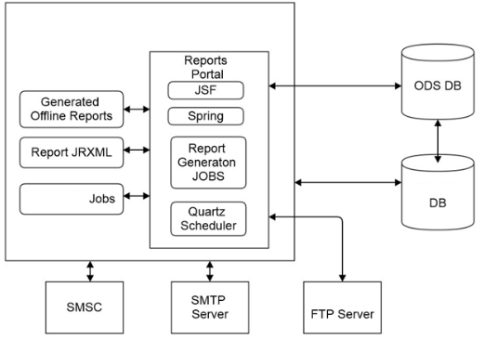
Solution Architecture:

Slide 6
Main Components
Quartz Scheduler Jobs
JSF View Layer
Spring Service Layer
Database Persistence Layer
Integration Layer
Logger

Slide 7
Tools which are used
Software/Hardware
Eclipse Java EE IDE for Web Developers.
Oracle SQL Developer
Notepad++
Shrew Soft VPN ACESS Manager
Cisco AnyConnect Secure Mobility Client
IP Messanger

Slide 8
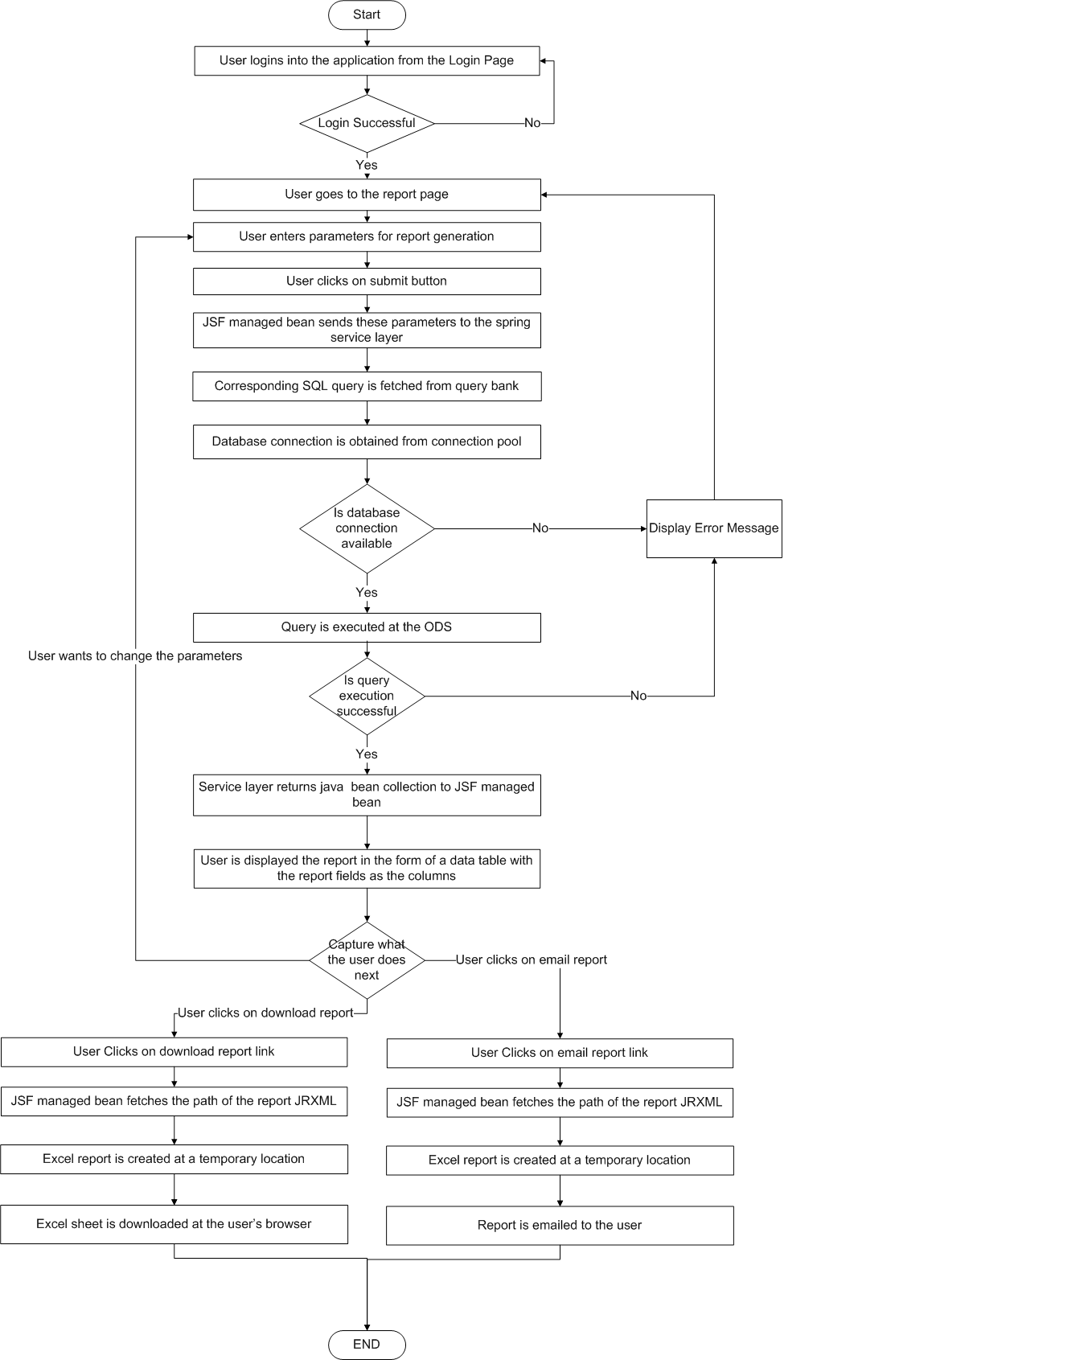

Slide 9
Process flow:
User logs into the system
User goes to the report page
User chooses the type of report and the various filters applicable to it from a JSF page
The JSF managed bean passing on the selection parameters to the spring service layer

Slide 10
The report SQL query is fetched from the query bank and the user selected parameters are set for the query
The query is then executed at the ODS
The service layer then sends a collection of report specific java beans

Slide 11
These report java beans are then displayed on the JSF page in the form of a table
The user is provided links to download the report and to email the report to their email account.
If the user wants to change the parameters again, the user enters the new parameters and clicks on submit
If the user is satisfied with the report data, the user can then download the report/ email it to their account by clicking on the link

Slide 12
When the user clicks on download report, the report jrxml is fetched and a temporary file is created at a preconfigured temporary folder.
This file is then sent to the user’s browser.
When the user clicks on email report, the report jrxml is fetched and a temporary file is created. This file is then sent to the user’s email address as an attachment.

Slide 13
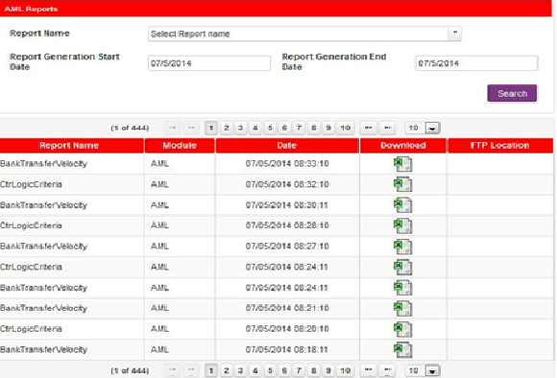
Mockup of Browsing Offline Report:

Slide 14
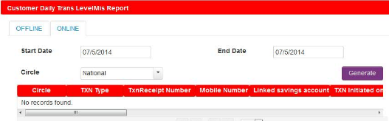
Mockup of Generating Online Report

Slide 15
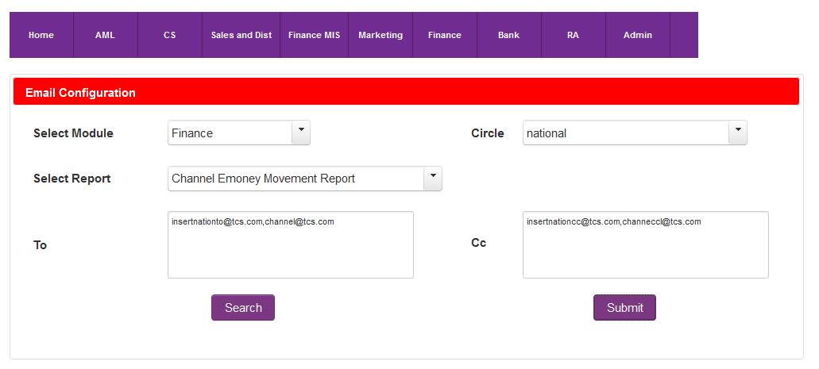
Email Configuration

Slide 16
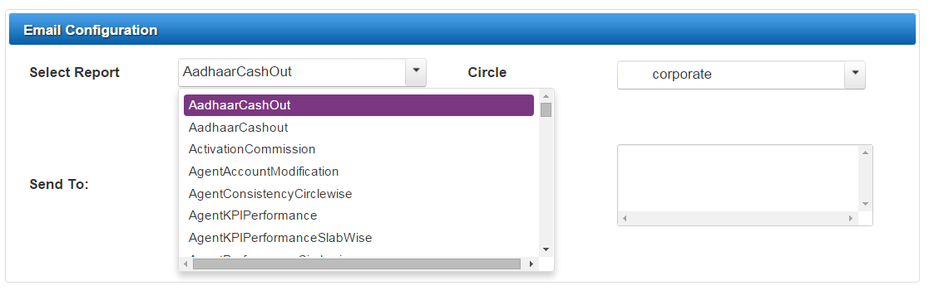
Email Configuration

Slide 17
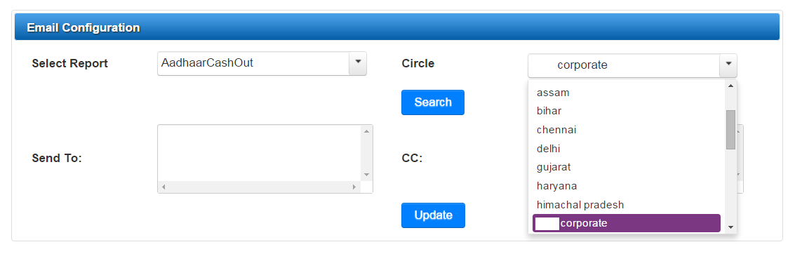
Email Configuration

Slide 18
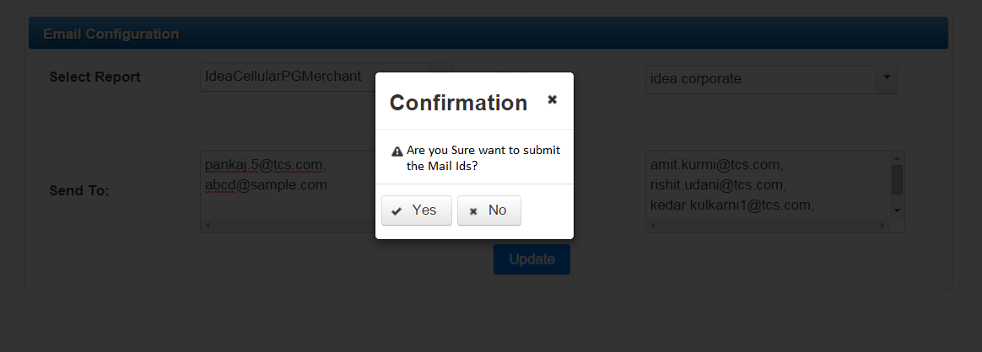
Email Configuration

Slide 19
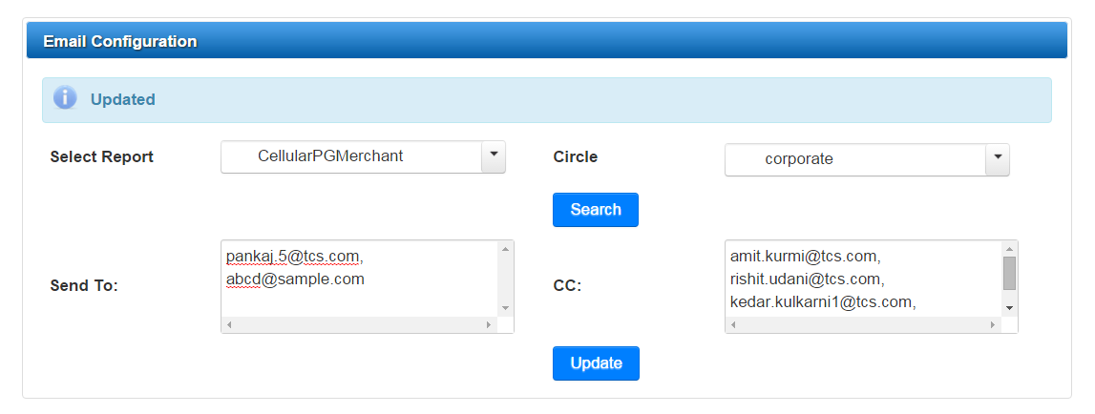
Email Configuration

Slide 20
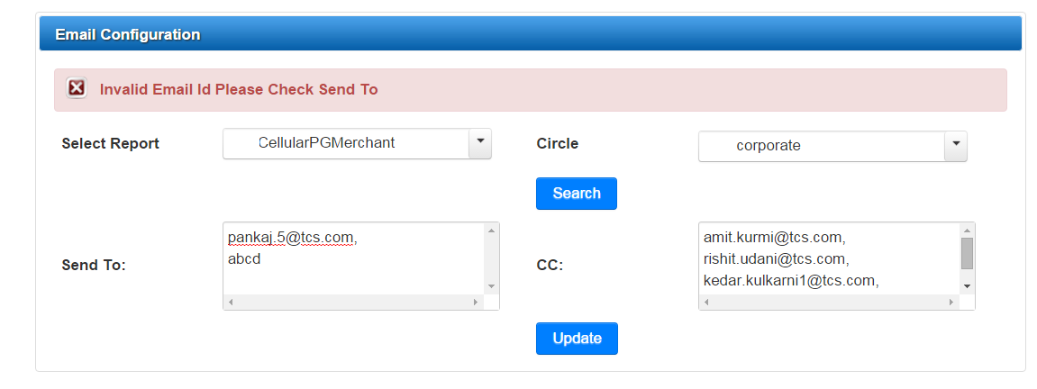
Email Configuration

Slide 21
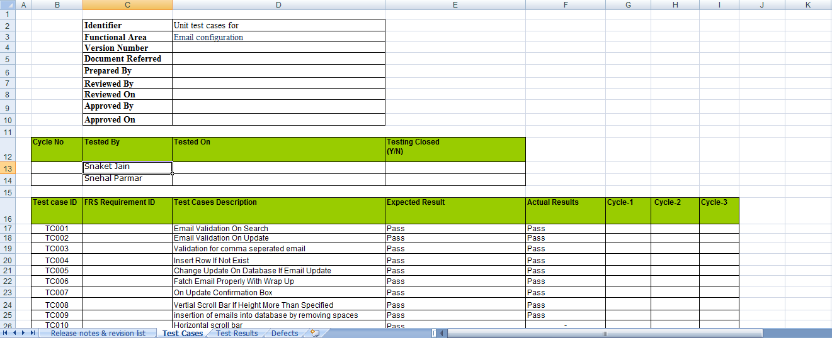
Test Cases

Slide 22
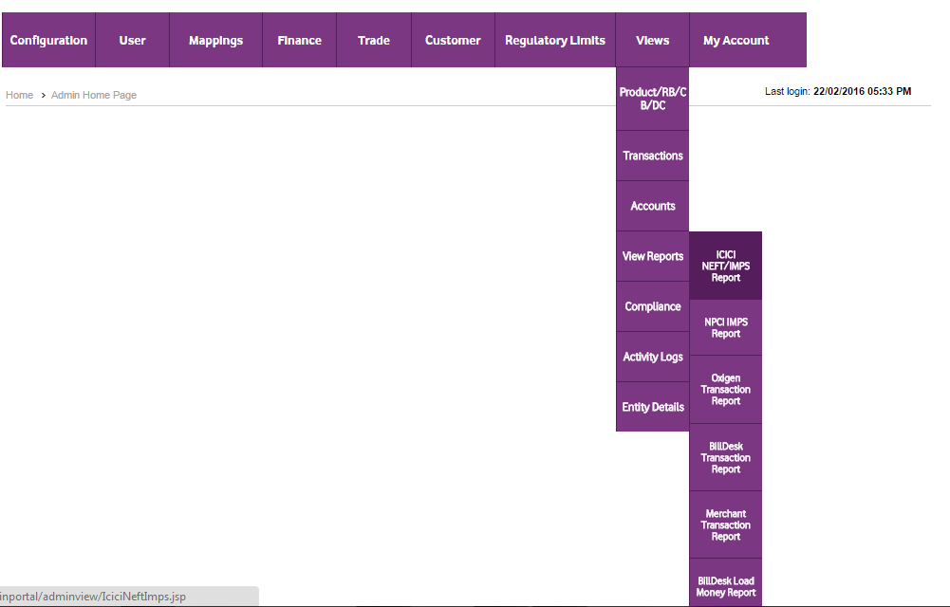
Admin View portal

Slide 23
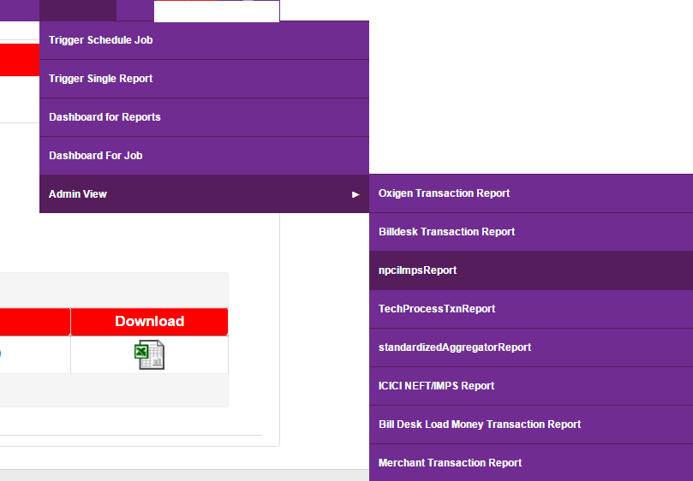
Report Portal

Slide 24
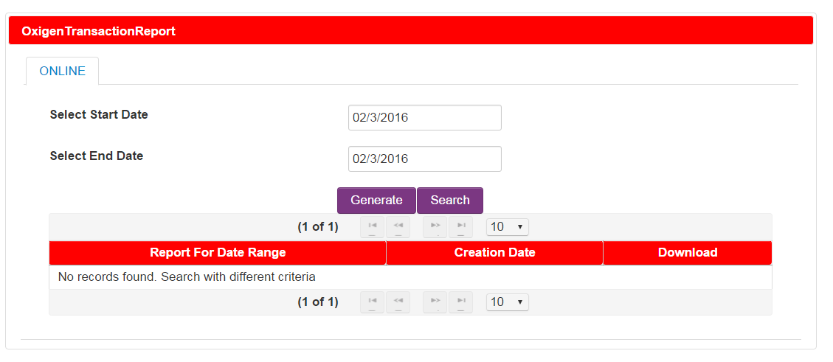
Report Portal(Report-1)

Slide 25
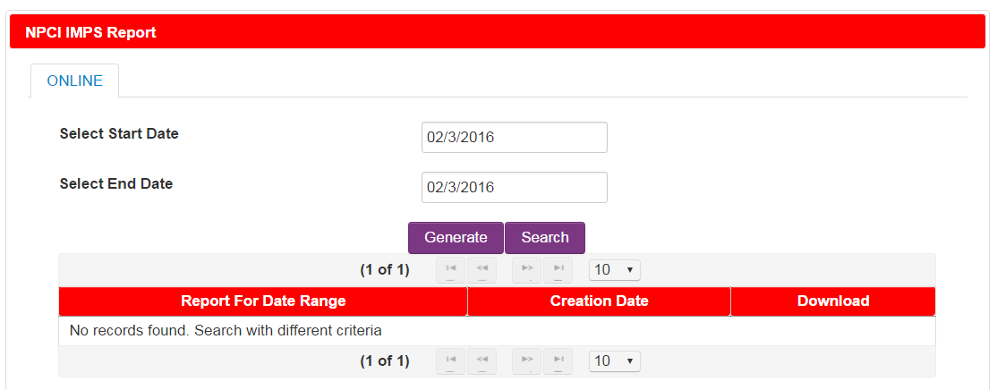
Report Portal(Report-2)

Slide 26
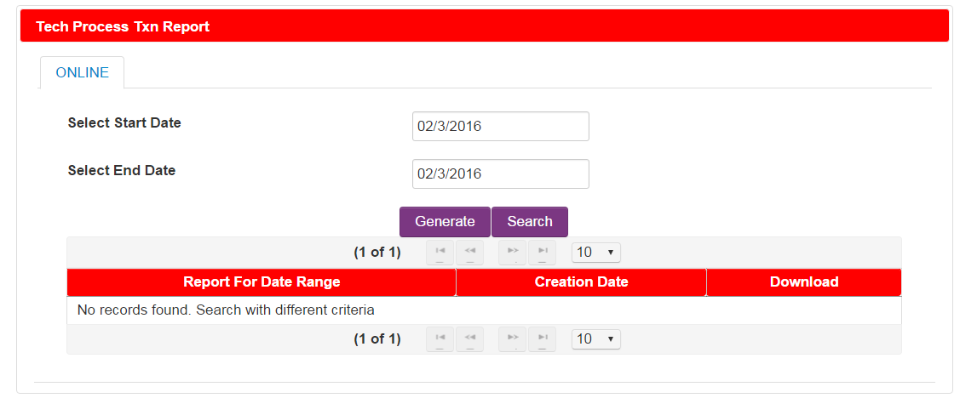
Report Portal(Report-3)

Slide 27
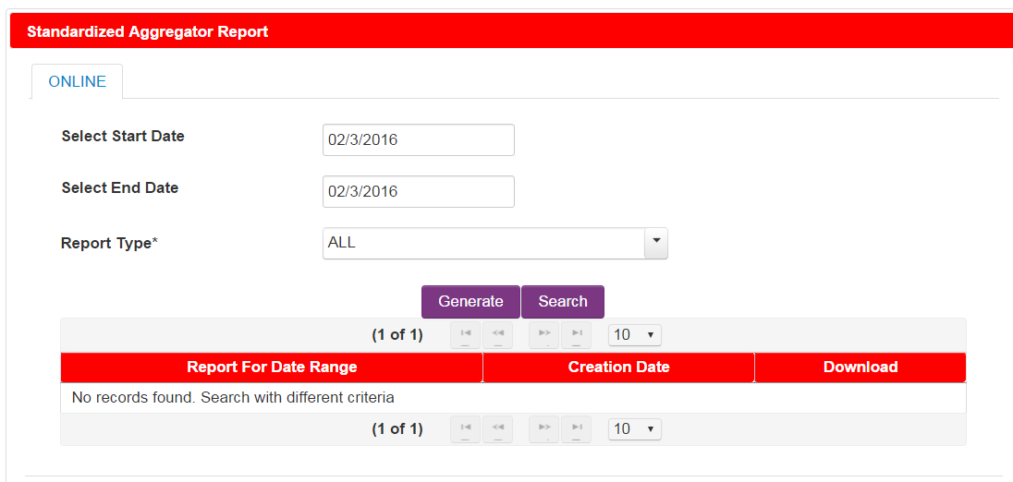
Report Portal(Report-4)

Slide 28
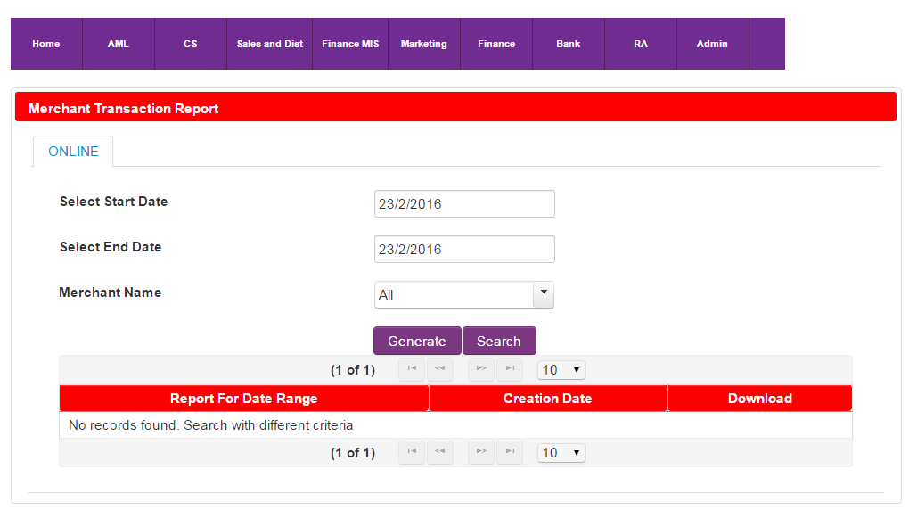
Report Portal(Report-5)

Slide 29
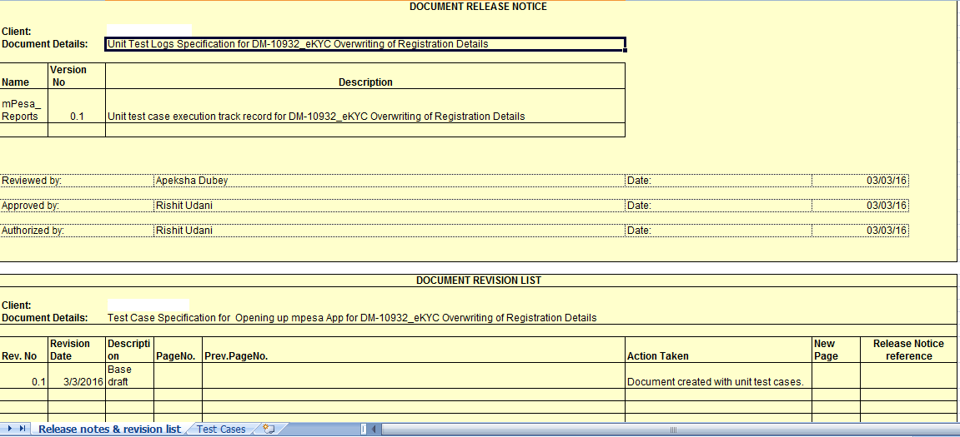
Customer Demand Analysis

Slide 30
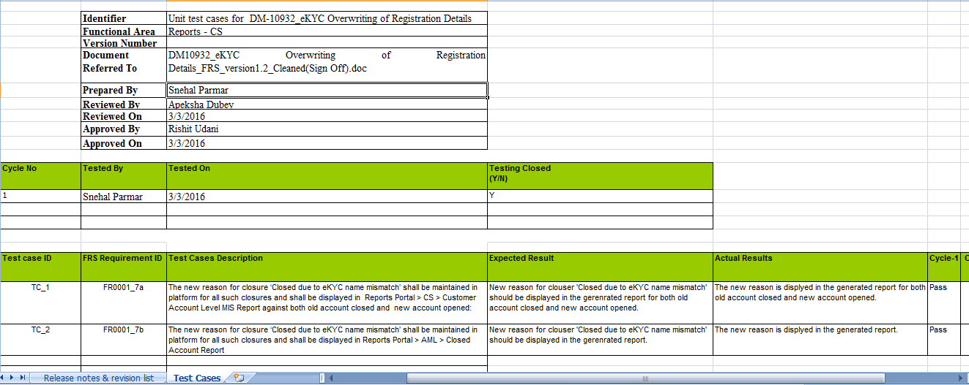
Customer Demand Analysis

Slide 31
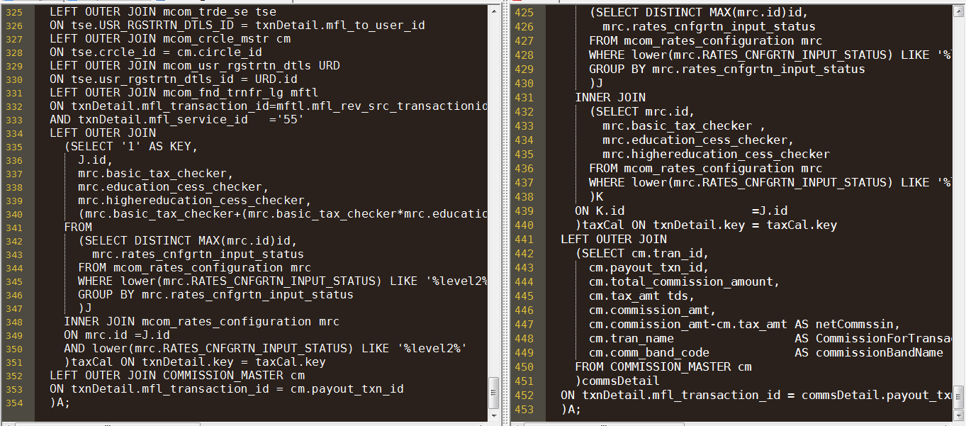
Query Optimization

Slide 32
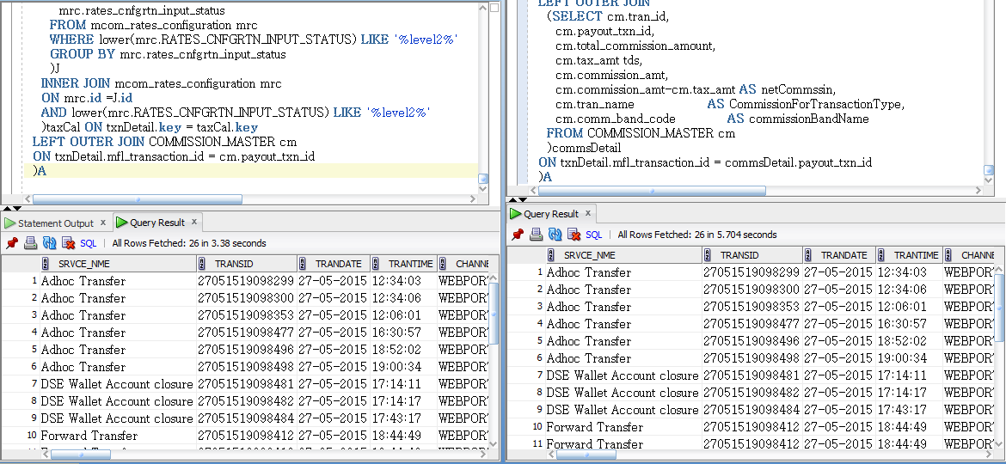
Query Optimization

Slide 33
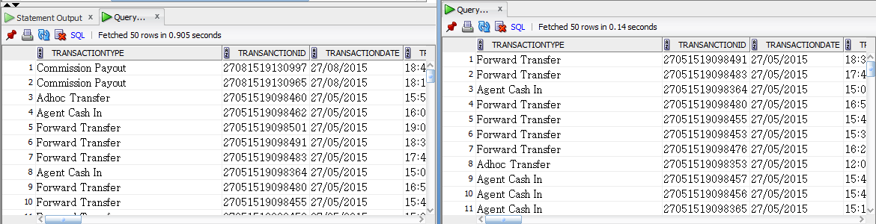
Query Optimization

Slide 34
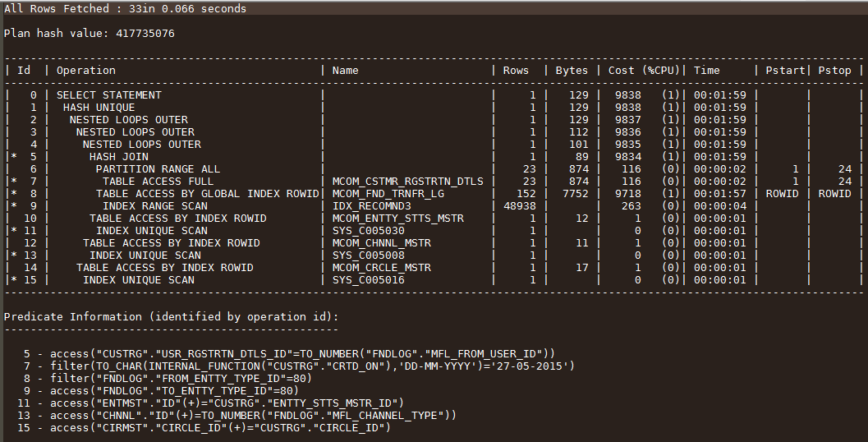
Explain plan-sql

Slide 35
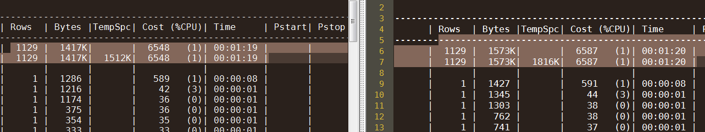
Explain plan-sql

Slide 36
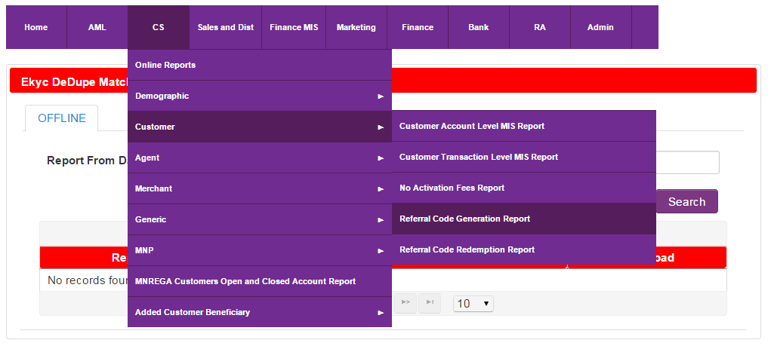
New Reports

Slide 37

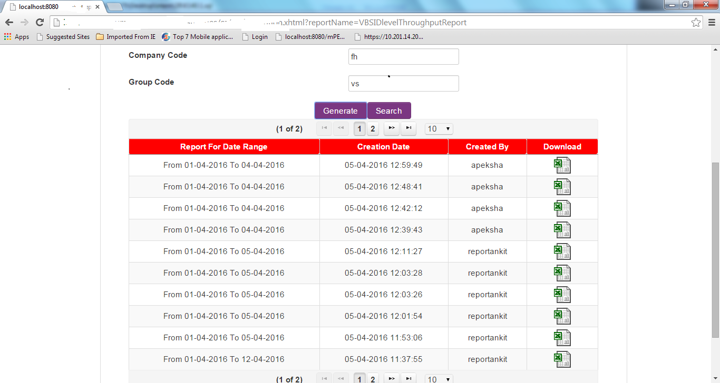

Slide 38
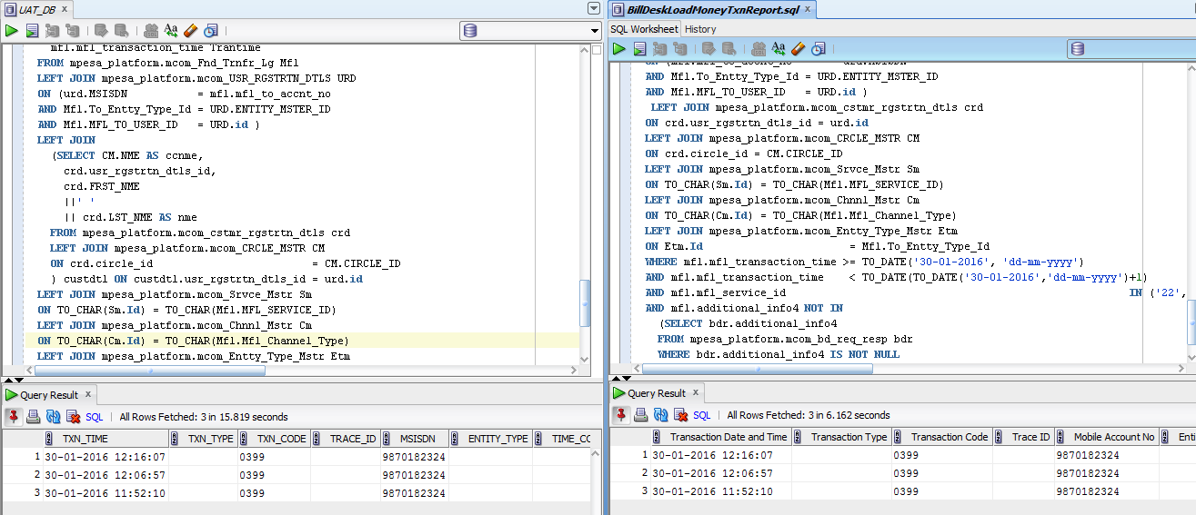

Slide 39
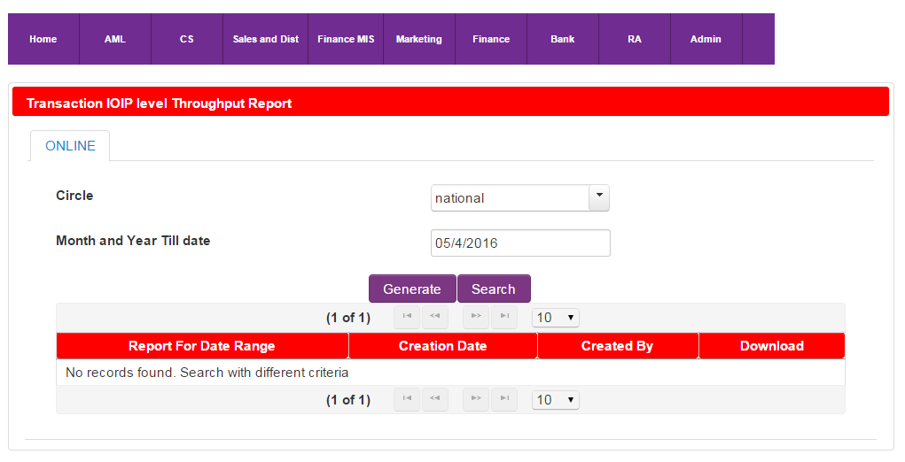
New Column addition

Slide 40
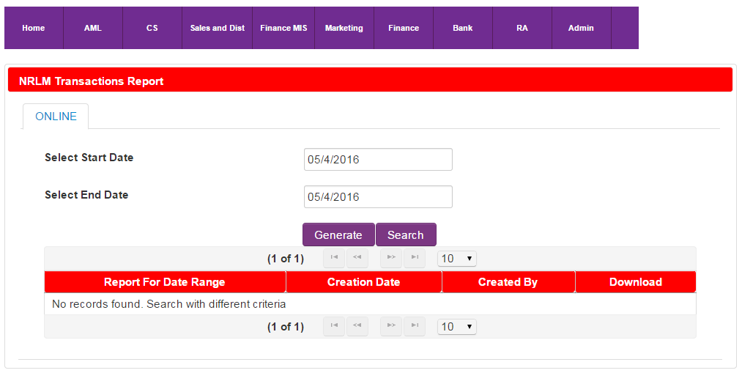

Slide 41
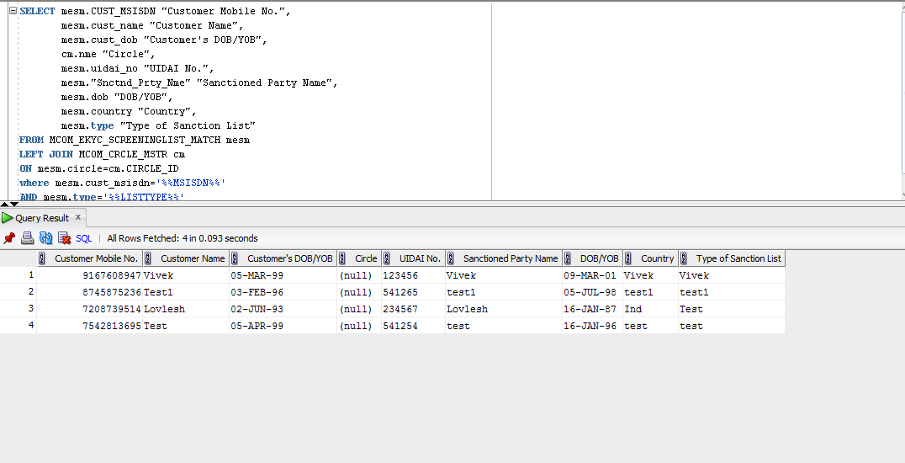

Slide 42
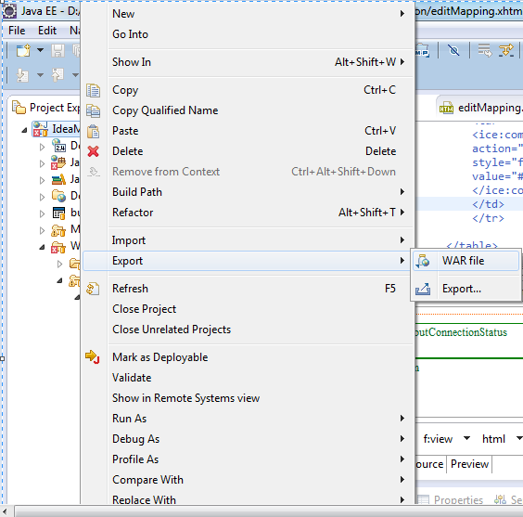
War Deployment

Slide 43
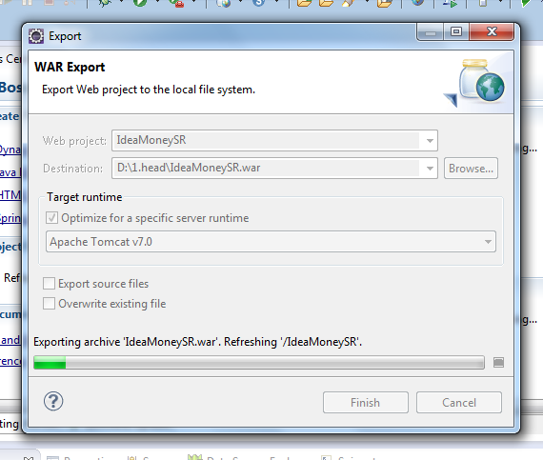
WAR Deployment

Slide 44
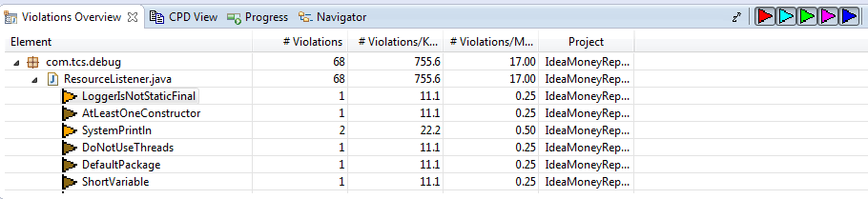
PMD Tool

Slide 45
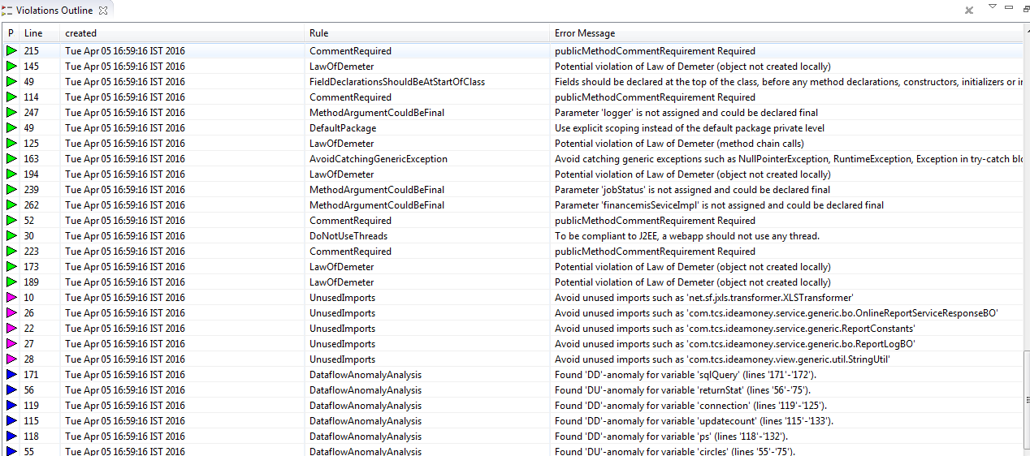
PMD Error Page

Slide 46
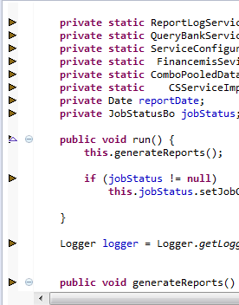
PMD

Slide 47
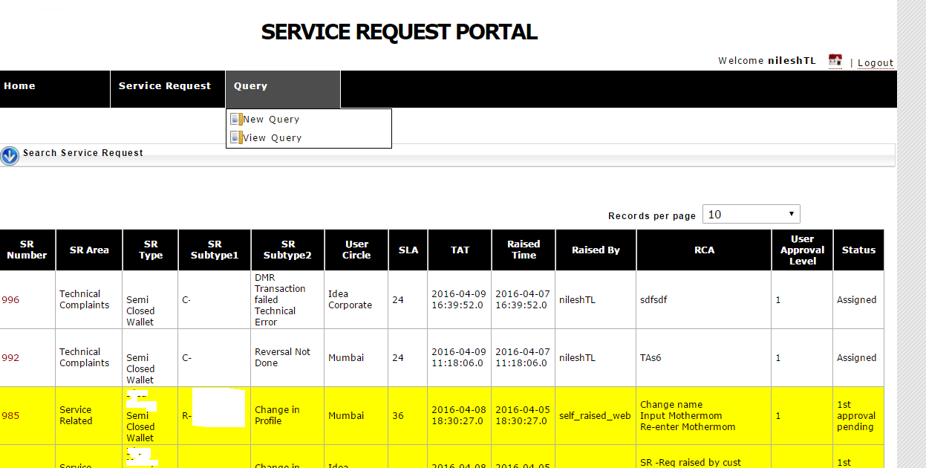
SR Portal

Slide 48
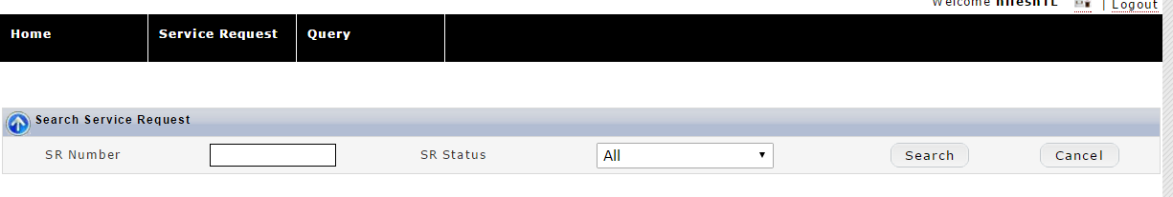
Search SR

Slide 49
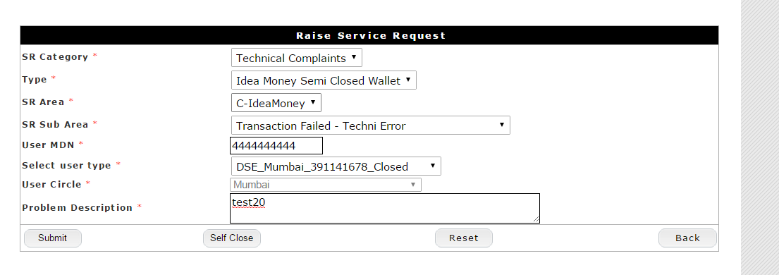
Raise NEW SR

Slide 50
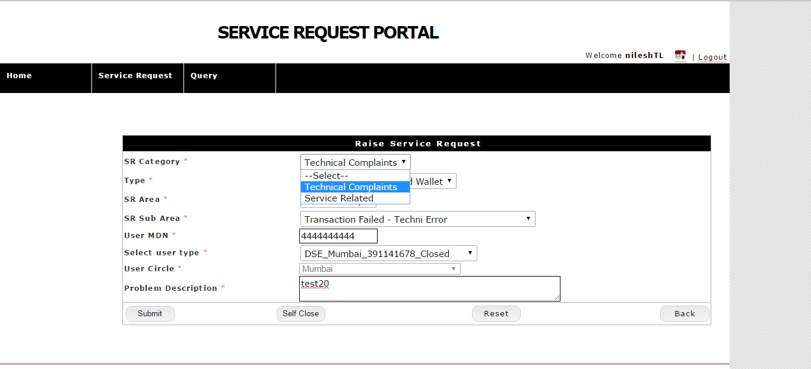

Slide 51
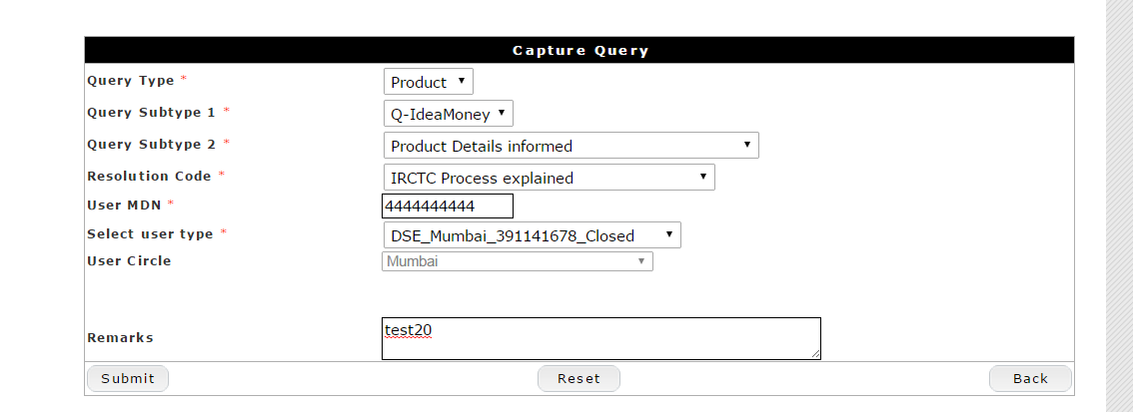
New Query

Slide 52
Thank You

